Slide 1



NUST CEME
Deep Reinforcement Learning
Intelligent path planning for self-driving UGV
Dr. Fahad Mumtaz Malik
Syed Shuhood
Awais Raza
Shabih Ahmad
Zawar Khan

Slide 2

Introduction
Our project focuses on developing intelligent path planning
for a self-driving Unmanned Ground Vehicle (UGV) utilizing
Deep Reinforcement Learning (DRL).
Leveraging DRL algorithms, our system enhances navigation
efficiency and adaptability, enabling the UGV to autonomously
plan and execute optimal paths in dynamic environments.
By integrating DRL into path planning, our project pushes the boundaries
of self-driving technology, prioritizing intelligent decision-making and real-time
adaptation for safe and efficient UGV navigation.

Slide 3
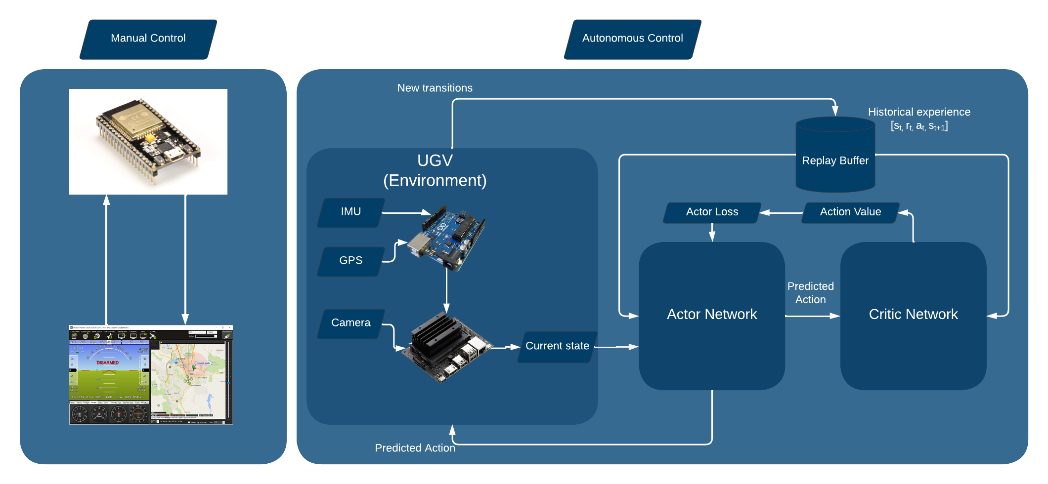

Block Diagram

Slide 4
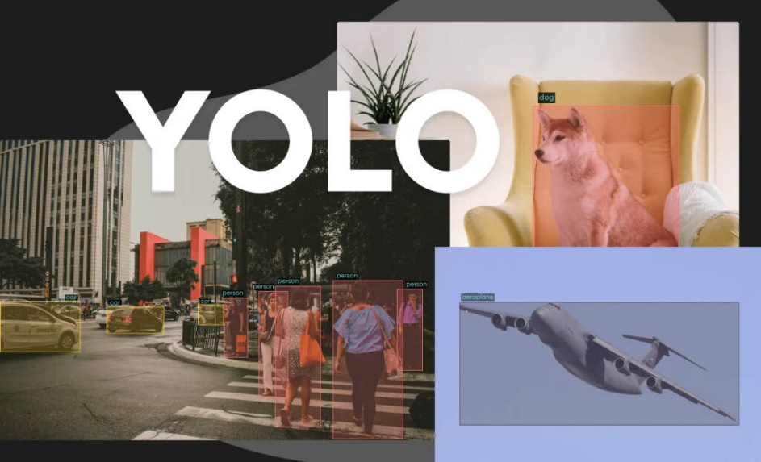
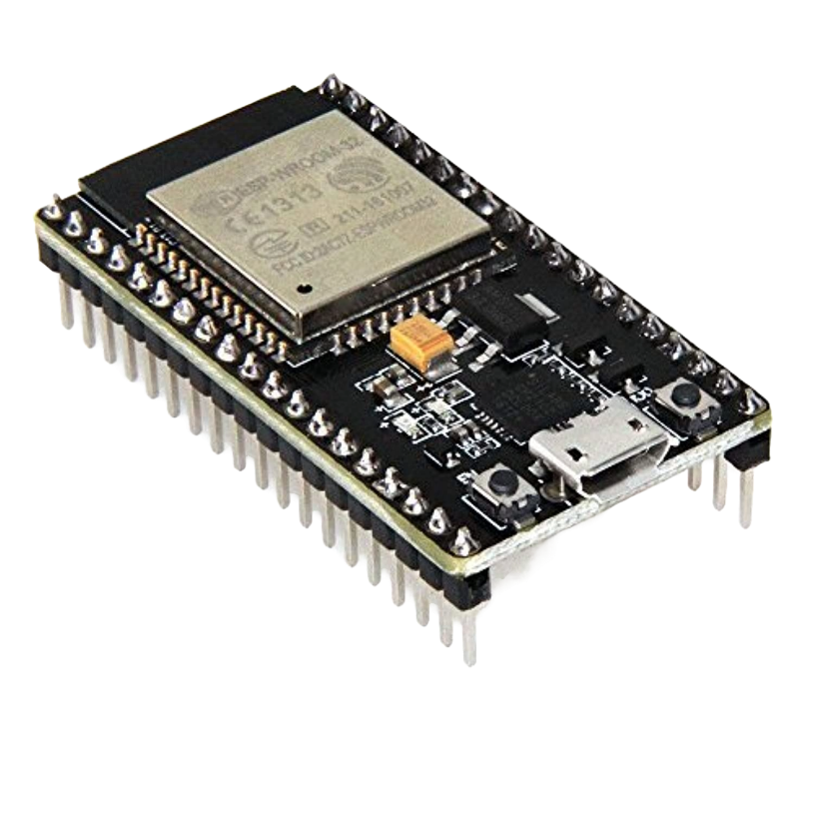

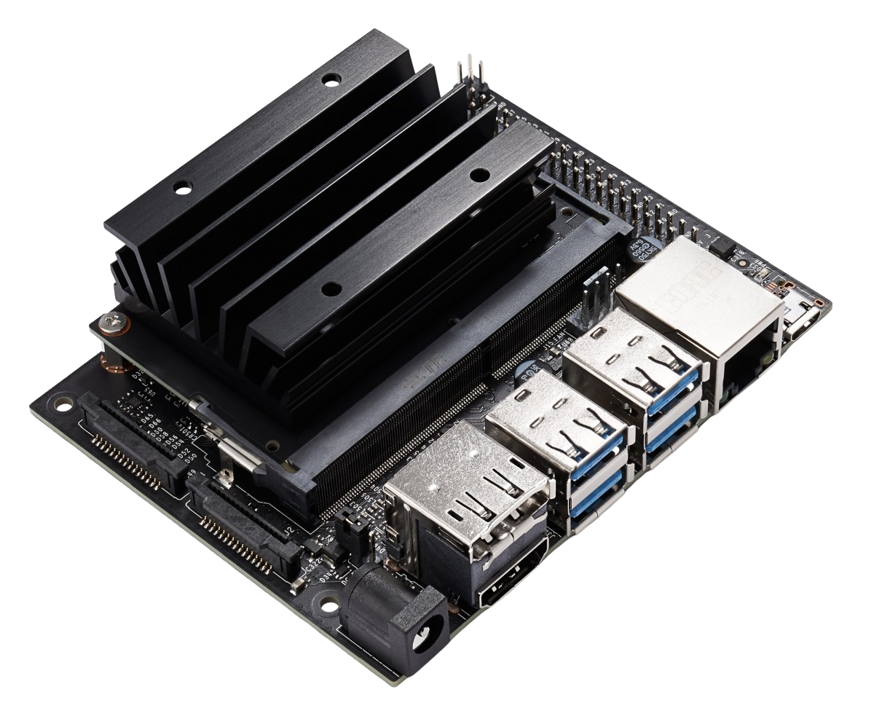
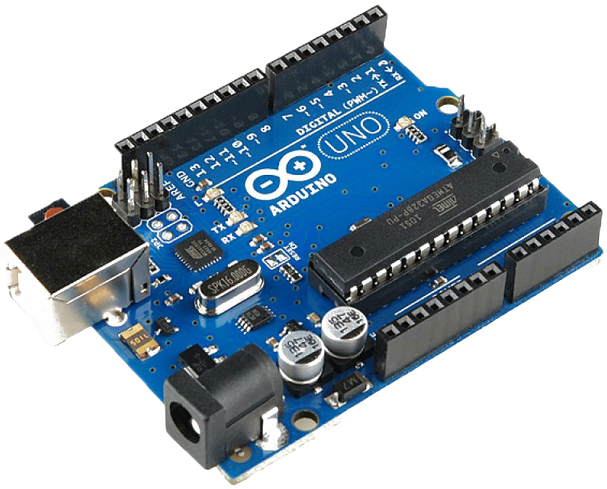
Software and Hardware

Slide 5
Tasks Assigned to each member
Members | Sensor Fusion (Arduino) |  | UGV Body Works |  | Carla DRL |  | Jetson Nano Integration |  |  | Body Assembly |  |  | Optim-isation | Literat-ure Review | Project docume-ntation
 | GPS | IMU | R.E. | Motor Control (ESP32) | Develo-pment | Training | DRL Model | Camera | Yolov | Ardu-ino | Jetson Nano | ESP32 | - | - | -
Shuhood ur Rehman | ✔ | ✔ |  | ✔ | I.P |  |  |  | ✔ | I.P |  | I.P | I.P
Awais Raza |  |  | ✔ | ✔ |  | I.P | I.P |  | ✔ | I.P |  | I.P | I.P
Zawar Khan |  |  | ✔ |  |  | I.P | I.P | I.P |  |  | I.P |  | I.P | ✔
Shabih Ahmad | ✔ | ✔ |  |  | I.P |  |  | I.P |  |  | I.P |  | I.P |  | I.P
行业PPT模板http://www.1ppt.com/hangye/

Slide 6
3 weeks
3 months/13 weeks
3 weeks
3 weeks

Slide 7
4 weeks
15 weeks
3 weeks
3 weeks

Slide 8
Conclusion
Our project demonstrates the effectiveness of integrating cutting-edge technologies, namely sensor fusion, deep reinforcement learning, and object detection, to achieve enhanced perception, adaptive decision-making, and efficient navigation and testing. This integration has the potential to significantly improve the success of reinforcement training and project execution in various fields.

Slide 9
References
Dolgov, D., Thrun, S., Montemerlo, M., Diebel, J. (2009). Path Planning for Autonomous Driving in Unknown Environments. https://doi.org/10.1007/978-3-642-00196-3_8
W. Othman and N. Shilov, "Deep Reinforcement Learning for Path Planning by Cooperative Robots: Existing Approaches and Challenges," 2021 28th Conference of Open Innovations Association (FRUCT), Moscow, Russia, 2021, pp. 349-357, doi: 10.23919/FRUCT50888.2021.9347628.
B Ravi Kiran, Ibrahim Sobh, Victor Talpaert, Patrick Mannion, Ahmad A. Al Sallab, Senthil Yogamani, Patrick Pérez, ” Deep Reinforcement Learning for Autonomous Driving: A Survey”,2020 Accepted for publication at IEEE Transactions on Intelligent Transportation Systems, https://doi.org/10.48550/arXiv.2002.00444
CARLA: An Open Urban Driving Simulator : Alexey Dosovitskiy, German Ros, Felipe Codevilla, Antonio Lopez, Vladlen Koltun

Slide 10

Q&A

